Slide 1



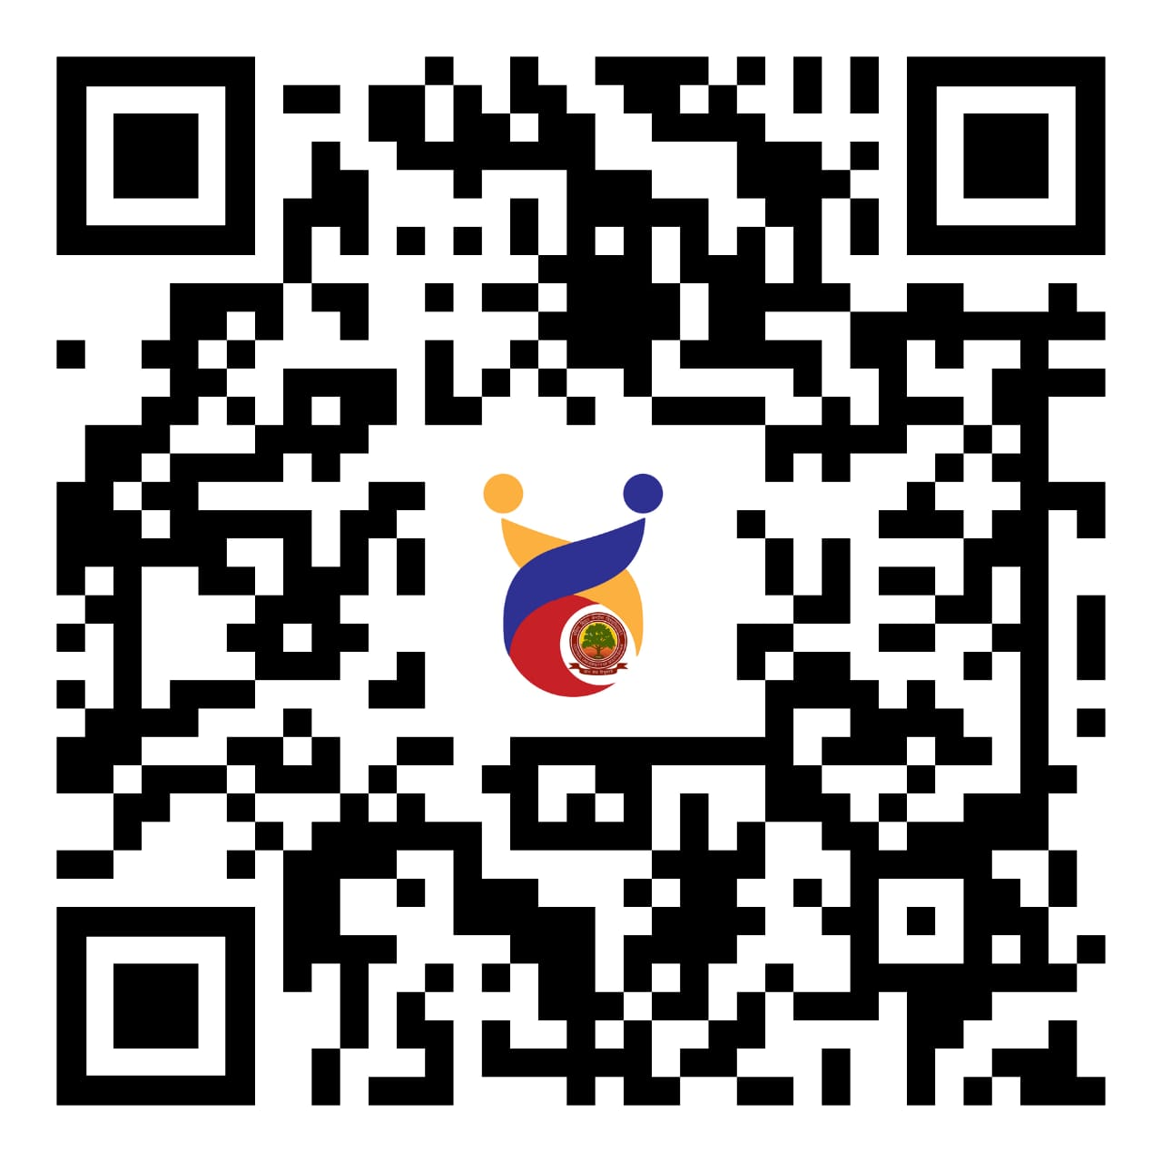
Showcase your Innovative ideas under the Innovation Activities
(Model Exhibition / Poster presentation)
APPROACHING GREEN TECHNOLOGY: SUSTAINABLE IMPACT ON THE SOCIETY
SUBTHEME
Ecofriendly Solutions for Environmental Pollution Control
Reduction of Health Hazards
Cost Reduction
Social Benefits
Improve Public Images Towards Sustainable Management
Energy Conservation
Policies to Achieve Sustainable Development Goals
Climate Friendly Lifestyle
Carbon Farming
Top 3 participants will receive:
Certificate of participation
Memento of appreciation
All participants will receive:
Certificate of participation
Click Here
To
Registration
IIC President
Prof. Venktesh Singh
(Professor)
Department of Physics
Faculty & Programme Coordinator
Dr. N.L. Devi
(Assistant Professor)
Department of Environmental Science
Innovation Activities Coordinator
Dr. Swati Gupta
(Assistant Professor)
Department of Teacher Education
Student Coordinator
Rajak Deepu Kumar
M.Sc. Environmental Science
Contact : 9409256277
DATE OF EVENT : 10.02.2025
Last Date of Registration: 07.02.2025

